Slide 1

TEACHING PORTFOLIO
WINNEBA SENIOR HIGH SCHOOL, WINNEBA
UNIVERSITY OF EDUCATION, WINNEBA
FACULTY OF SCIENCE EDUCATION
DEPARTMENT OF ICT EDUCATION
NAME: Dzah Jennifer
INDEX NUMBER: 5231570193
SCHOOL OF PRACTICE: Winneba Senior High School
SUPERVISOR: Mr.'s Esther Gyimah
www.winnesec.edu.gh

Slide 2

Post-Internship Presentation ICT Education
WINNEBA SENIOR HIGH SCHOOL, WINNEBA
Welcome to my presentation on my internship experience at Winneba Senior High School. Today I’ll take you through the school’s profile, vision, and mission, then share how I applied my teaching skills in real classroom settings.
www.winnesec.edu.gh

Slide 3
Presentation Outline
WINNEBA SENIOR HIGH SCHOOL, WINNEBA
School Profile & Vision ( WINNEBA SENIOR HIGH SCHOOL )
Still photograph (Still photograph )
Still photograph (Pictures of academic album)
Activities & Challenges (Key activities undertaken and obstacles encountered.)
Lessons & Recommendations (Insights gained and future suggestions for ICT education.)
www.winnesec.edu.gh

Slide 4
MY GOALS FOR THE INTERNSHIP
WINNEBA SENIOR HIGH SCHOOL, WINNEBA
Improve my teaching skills by delivering lessons and engaging students in class
Apply ICT knowledge by using basic computer skills to support learning
Learn classroom management and how to handle students professionally
Gain practical experience to connect what I studied with real teaching
Build confidence and work well with teachers, staff, and students
www.winnesec.edu.gh

Slide 5
WINNEBA SENIOR HIGH SCHOOL Profile and Vision
WINNEBA SENIOR HIGH SCHOOL, WINNEBA
About Winneba Senior High School Established in 1949 as Ghana Secondary and Commercial Academy, Winneba SHS is a mixed-gender public school in Winneba, Central Region. It runs a double-track system and focuses on developing students through self-discipline and self-awareness
www.winnesec.edu.gh

Slide 6
MY GOALS FOR THE INTERNSHIP
WINNEBA SENIOR HIGH SCHOOL, WINNEBA
Improve my teaching skills by delivering lessons and engaging students in class
Apply ICT knowledge by using basic computer skills to support learning
Learn classroom management and how to handle students professionally
Gain practical experience to connect what I studied with real teaching
Build confidence and work well with teachers, staff, and students
www.winnesec.edu.gh

Slide 7
VISION AND MISSION OF THE SCHOOL
WINNEBA SENIOR HIGH SCHOOL, WINNEBA
Vision
To become a world-class second-cycle institution that produces graduates with exceptional leadership and innovative abilities to meet the ever-changing and increasing manpower needs of the nation.
Mission
To harness qualified and motivated staff and material resources to create equal opportunities for young boys and girls to develop their inherent potentials through self-awareness, self-discipline, and excellence.
www.winnesec.edu.gh

Slide 8
MY DUTIES DURING INTERNSHIP
WINNEBA SENIOR HIGH SCHOOL, WINNEBA
Prepared Excel sheet to record students’ results
Events: Helped organize Carol Service and Inter-School Games
Exams: Assisted in invigilation and printing of learning materials
Support: Conducted prefect elections + registered Form 3 students
www.winnesec.edu.gh

Slide 9
Challenges and Lessons Learned
WINNEBA SENIOR HIGH SCHOOL, WINNEBA
CHALLENGES
Classroom management: Controlling large classes was tough at first
Time management: Balancing teaching, marking, and school duties Tech issues: Limited ICT tools made practical lessons difficult
Communication: Adapting my teaching style to different student levels
LESSONS LEARNED
Patience: Students learn at different speeds, so patience is key
Planning: Good lesson planning makes teaching easier
Teamwork: Working with teachers taught me the value of collaboration Confidence: The experience built my confidence in public speaking and leadership
www.winnesec.edu.gh

Slide 10
Recommendations and Conclusion
WINNEBA SENIOR HIGH SCHOOL, WINNEBA
RECOMMENDATIONS: More ICT resources: Schools should provide more computers and projectors for practical lessons
Intern training: Organize orientation for interns before posting to schools Student support: Reduce class sizes to help teachers manage students better
Regular supervision: Lecturers should visit interns often for guidance and feedback
CONCLUSION
My internship at Winneba Senior High School was a valuable learning experience. It helped me apply my ICT knowledge, improve my teaching skills, and build confidence. I gained practical experience in classroom management, assessment, and teamwork. This experience has prepared me better for my future career in education.
www.winnesec.edu.gh

Slide 11
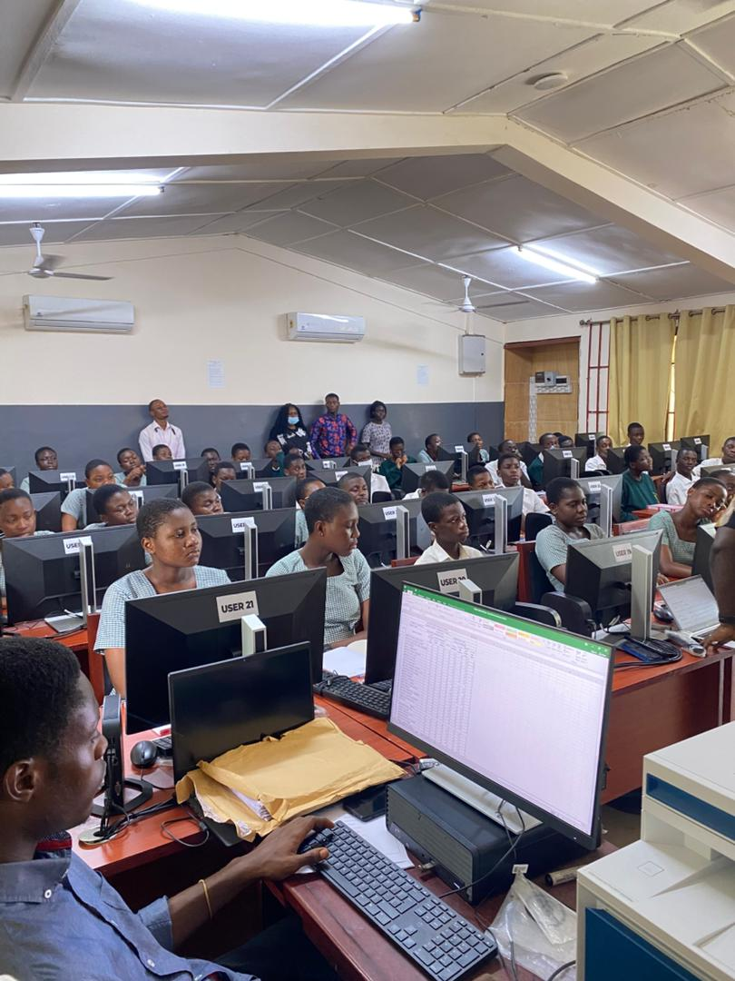
WINNEBA SENIOR HIGH SCHOOL, WINNEBA
www.winnesec.edu.gh

Slide 12
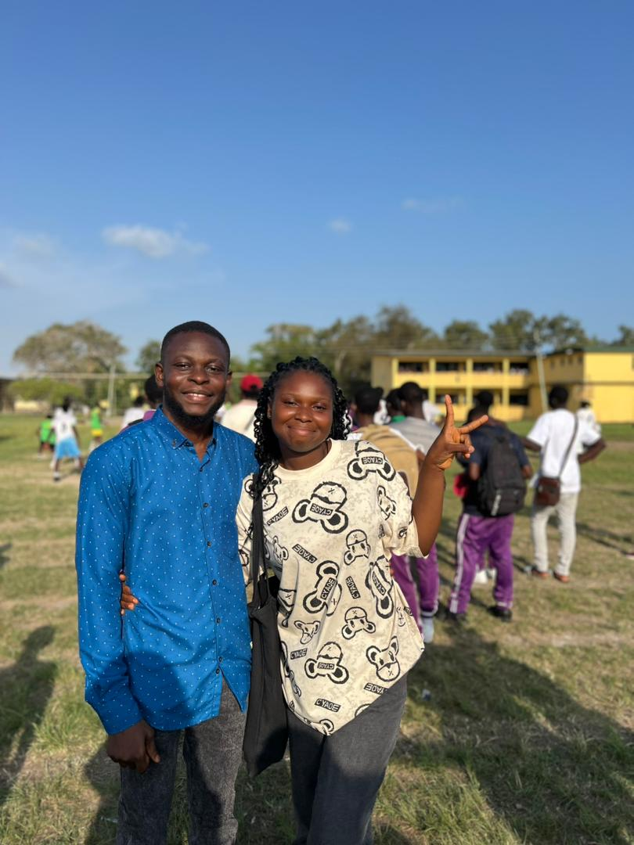
WINNEBA SENIOR HIGH SCHOOL, WINNEBA
www.winnesec.edu.gh

Slide 13

THANK YOU

